Slide 1



Web application to store and analyze data on the impact of social determinants of health

Slide 2

GROUP-19
Afza Noor Fowzia. ID: 2010078
Fatema Jannat. ID: 2030420
Kaushik Dey Joy. ID: 1821818
Mahima Rahman Waishee. ID: 1910030
Mahmudul Hasan Sheepu. ID: 1931349

Slide 3
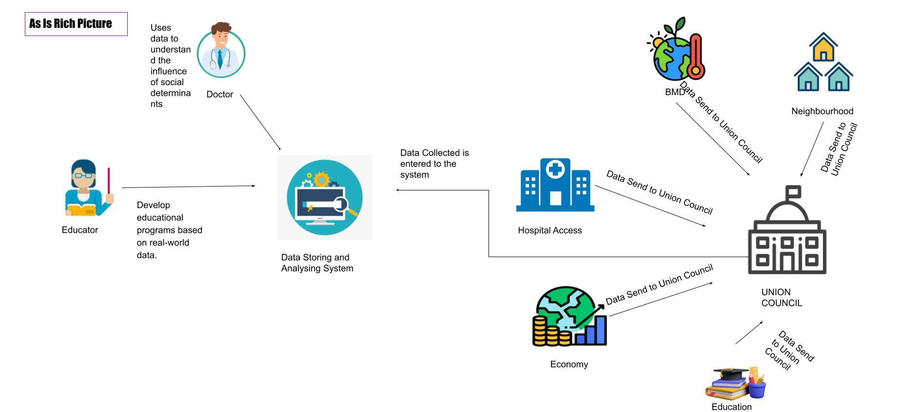
AS IS Rich Picture

Slide 4
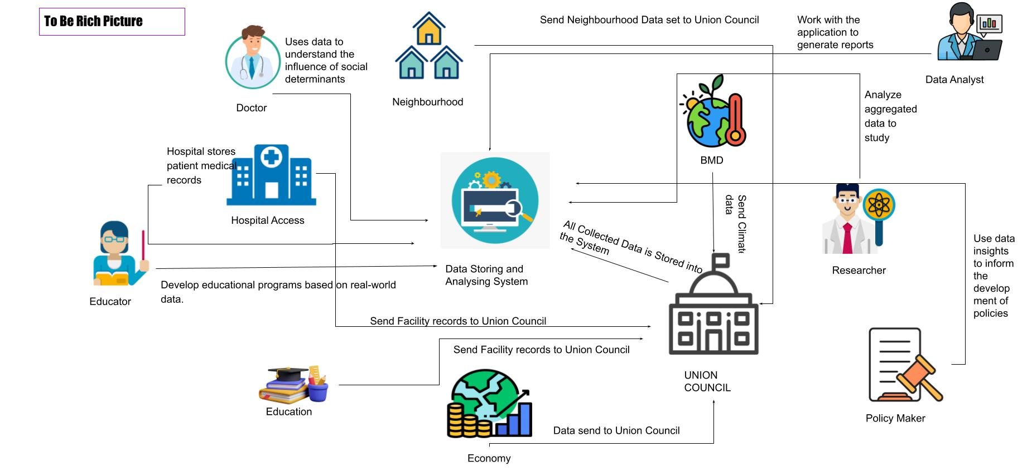
TO BE Rich Picture

Slide 5
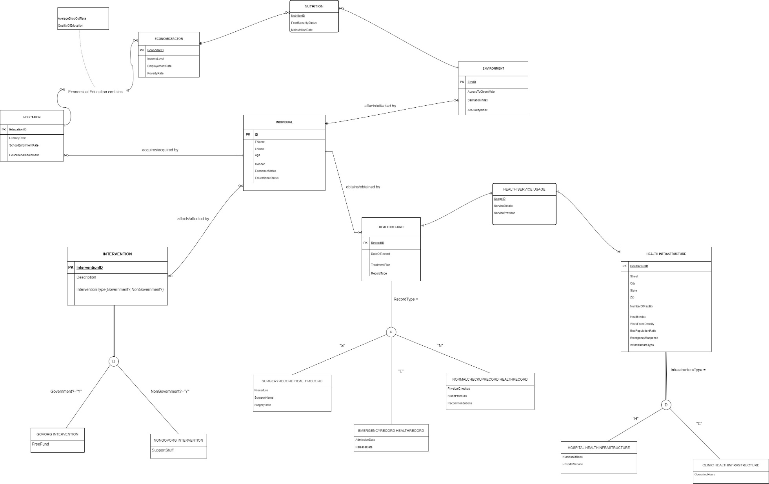
ERD

Slide 6
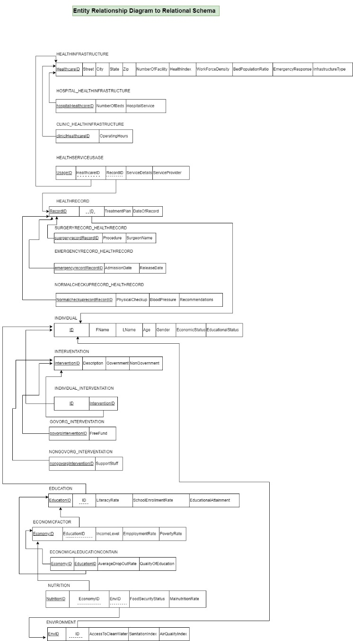
RelationAL Schema

Slide 7
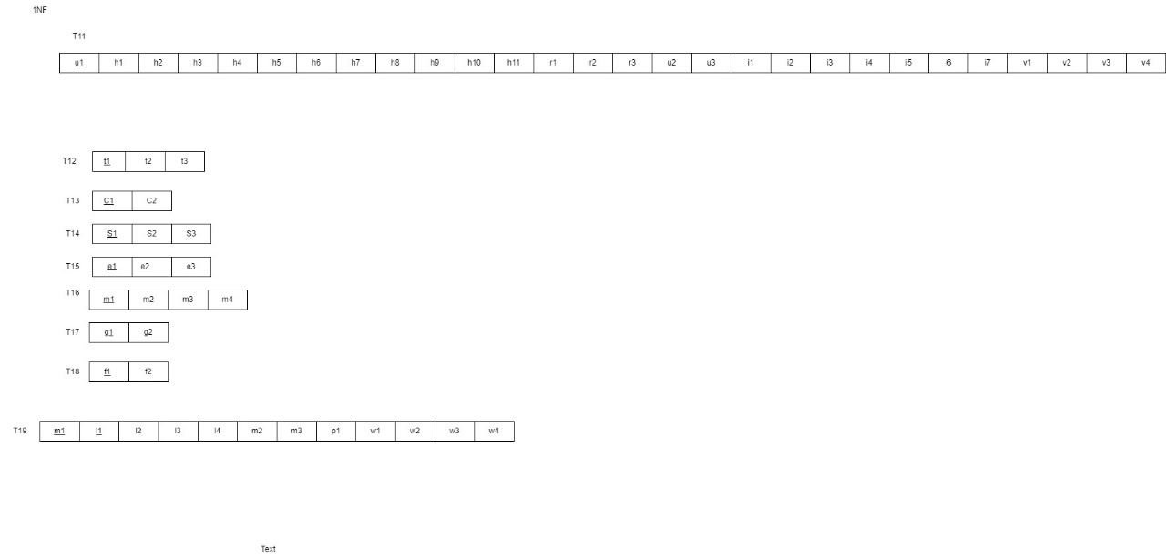
Normalization

Slide 8
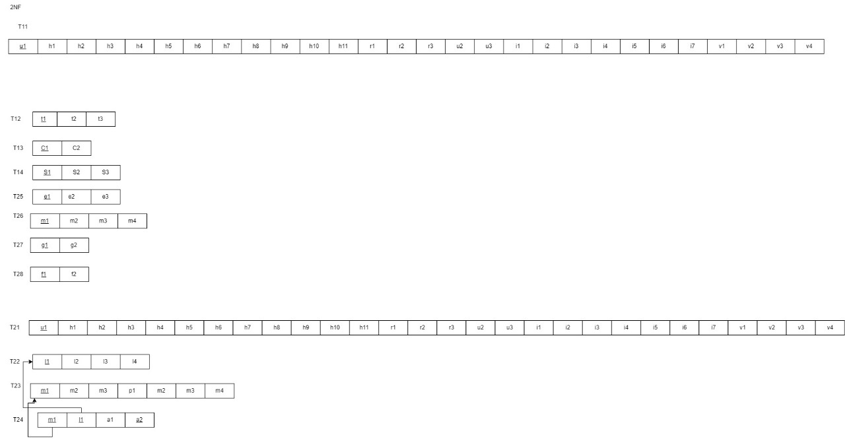
Normalization

Slide 9
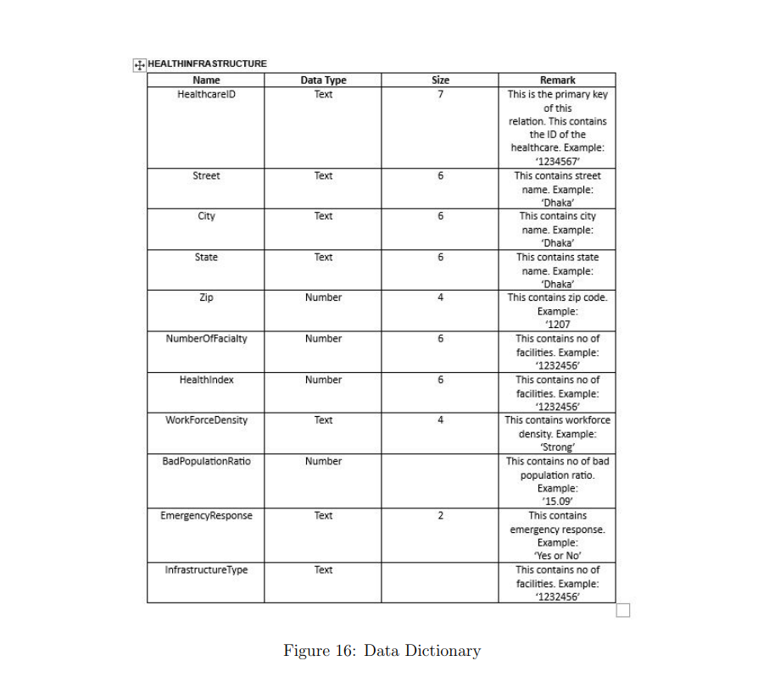
Implemented Database Tables

Slide 10
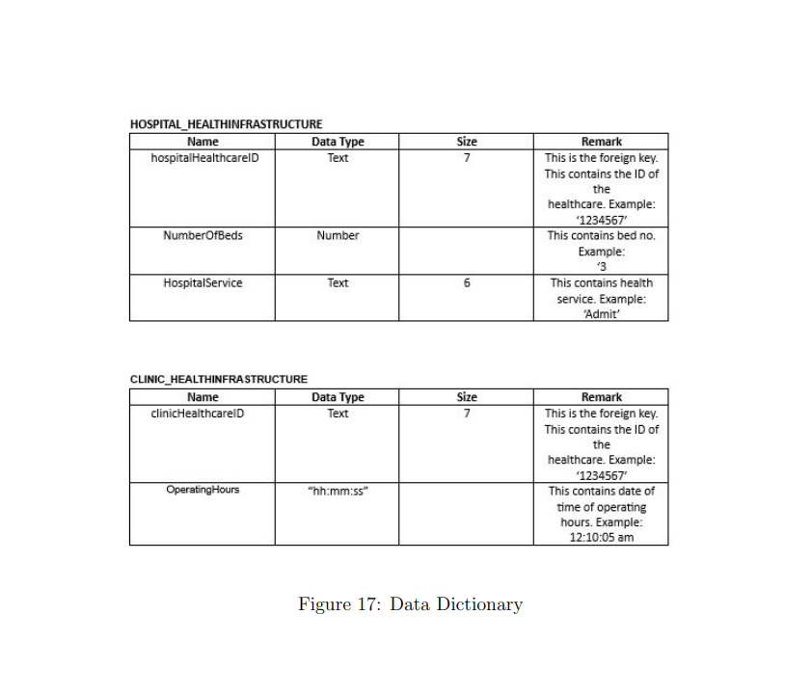
Implemented Database Tables

Slide 11
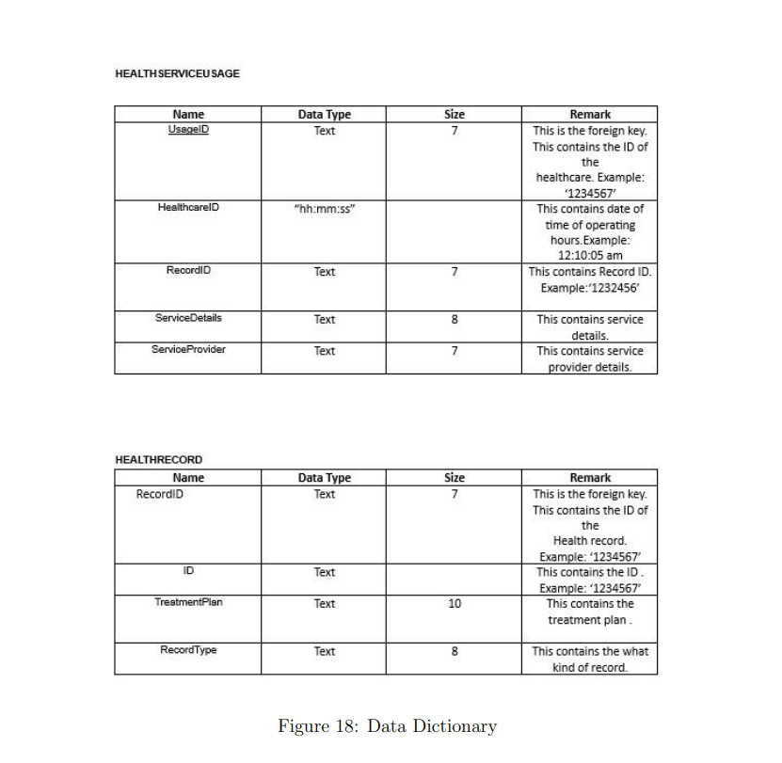
Implemented Database Tables

Slide 12
